Slide 1

Web-Based To-Do List
Application: A Project Report
This report details the journey of creating an interactive to-do list
application using core web technologies: HTML, CSS, and JavaScript. The
application is designed to be simple and responsive, allowing users to
efficiently manage their tasks by adding, editing, deleting, and marking
them as complete.
This project served as an invaluable hands-on experience in front-end
development, solidifying understanding of DOM manipulation, event
handling, and responsive design principles. The report covers the
development process, implemented features, challenges encountered,
and key learnings, concluding with potential future enhancements.

Slide 2
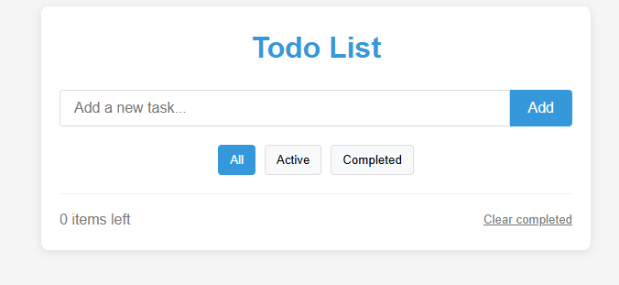
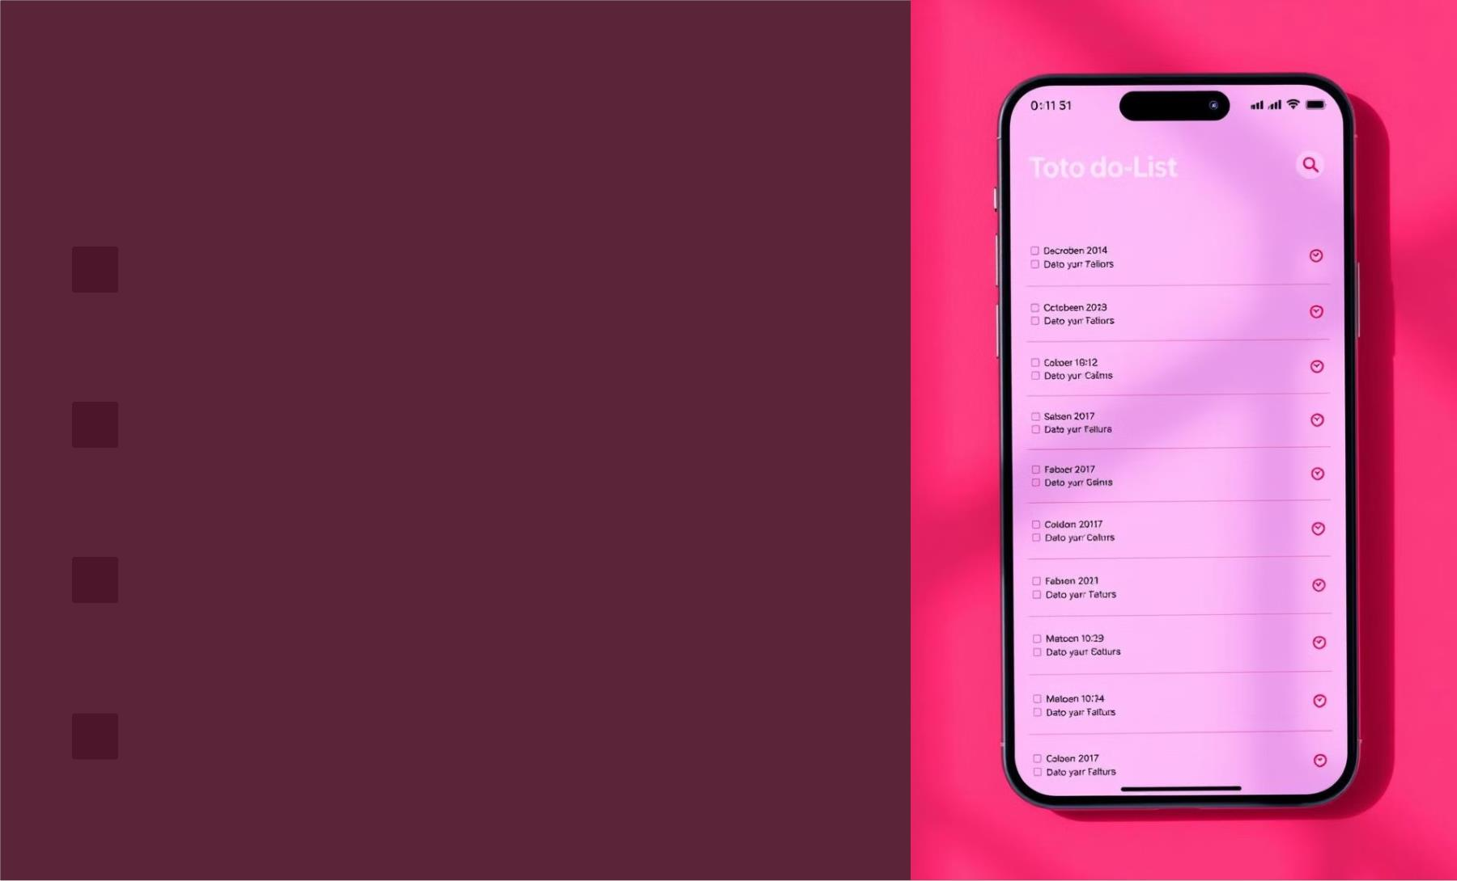
Implemented Core
Functionalities
1
2
3
Add Task
Users can easily input new tasks via a text field and append them
to their list, ensuring quick addition of to-dos.
Edit Task
Existing tasks can be modified through an intuitive edit function,
allowing for easy correction and updates.
Delete Task
Unnecessary or completed tasks can be permanently removed,
maintaining a clean and organized list.
4 Mark as Complete
Tasks can be marked as completed, visually distinguished with a
strikethrough, providing a sense of accomplishment.

Slide 3

Intuitive User Interface and Responsive Design
Clean and Intuitive Design
Responsive Layout
The application boasts a user-friendly interface, ensuring
ease of use and navigation for all users.
Designed to adapt seamlessly to different screen sizes,
providing an optimal viewing experience on desktops and
mobile devices.
Simple visual layout
Easy to find actions
Flexbox and Grid
Mobile-first approach

Slide 4
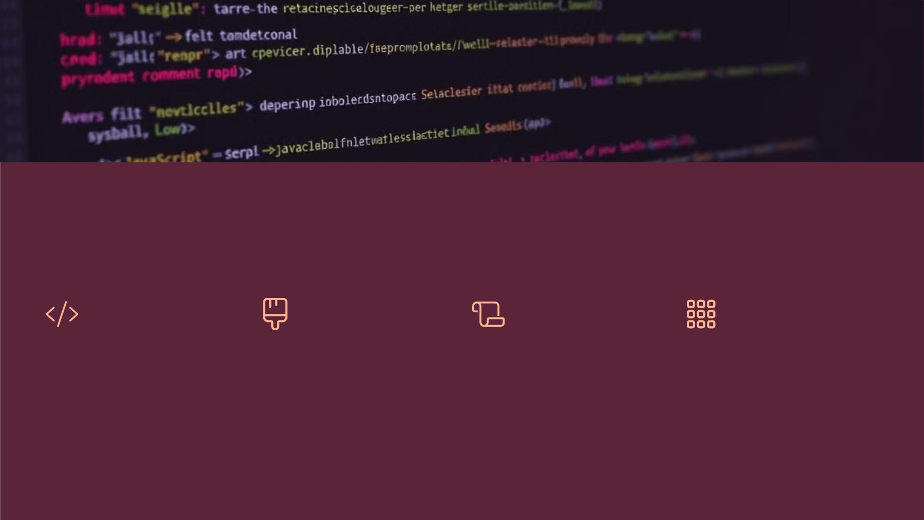
Technologies Stack
HTML
CSS
JavaScript
Flexbox/Grid
Provides the
Handles the styling
and layout, ensuring a
visually appealing and
consistent user
Enables dynamic task
management,
Facilitates responsive
design, ensuring the
application adapts to
various screen sizes
and devices.
structural foundation
of the web page,
organizing elements
and content.
allowing users to
interact with and
manipulate tasks in
real-time.
experience.

Slide 5
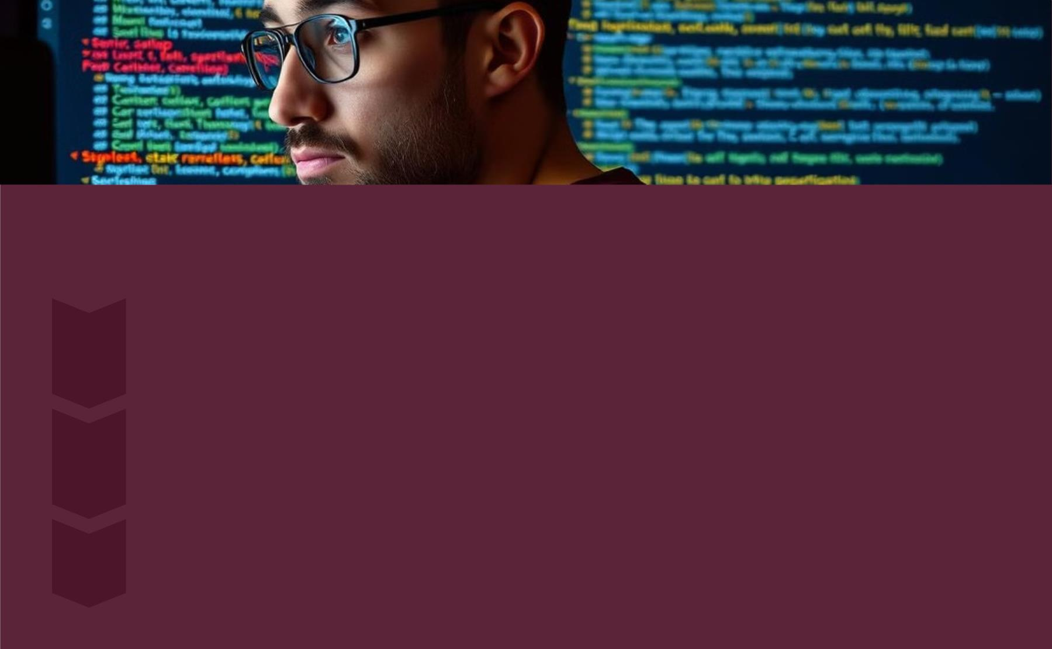
Overcoming Development Challenges
Dynamic Task Management
1
Implementing functions to add, edit, and delete tasks without causing unintended side effects or data
corruption.
Responsive Design
2
3
Ensuring the layout adapts seamlessly to different screen sizes, maintaining usability and visual appeal across
devices.
User Input Validation
Preventing empty tasks from being added, enhancing data integrity and user experience.

Slide 6

Key Learning Outcomes
DOM Manipulation
1
Gained experience in dynamically updating HTML elements, enhancing interactivity.
Event Handling
2
Learned how to handle button clicks and user interactions, improving user
engagement.
Responsive Design
3
Improved skills in making web applications work across
devices, ensuring broad accessibility.

Slide 7

Future Enhancements for an Improved
Experience
Local Storage
1
Drag-and-Drop
Save tasks between sessions
2
Reordering tasks
Cloud Sync
4
Categories/Tags
3
Sync tasks between devices
Organize tasks
These additions would significantly enhance the application's usability and feature set, making it a more robust and user-
friendly tool for task management. The addition of categories and tags can provide a robust tool for o

Slide 8

Conclusion
The project successfully delivered a functional to-do list application using
HTML, CSS, and JavaScript. It served as a valuable learning experience in
front-end development, reinforcing key concepts such as DOM
manipulation, event handling, and responsive design. The application is
both simple and effective, offering a solid foundation for future
enhancements.
Key takeaways from the project include the importance of a well-
structured HTML foundation, the power of CSS for creating visually
appealing interfaces, and the versatility of JavaScript for enabling
dynamic and interactive user experiences. The challenges faced and
overcome during the development process have significantly contributed
to a deeper understanding of web development principles.

